Slide 1
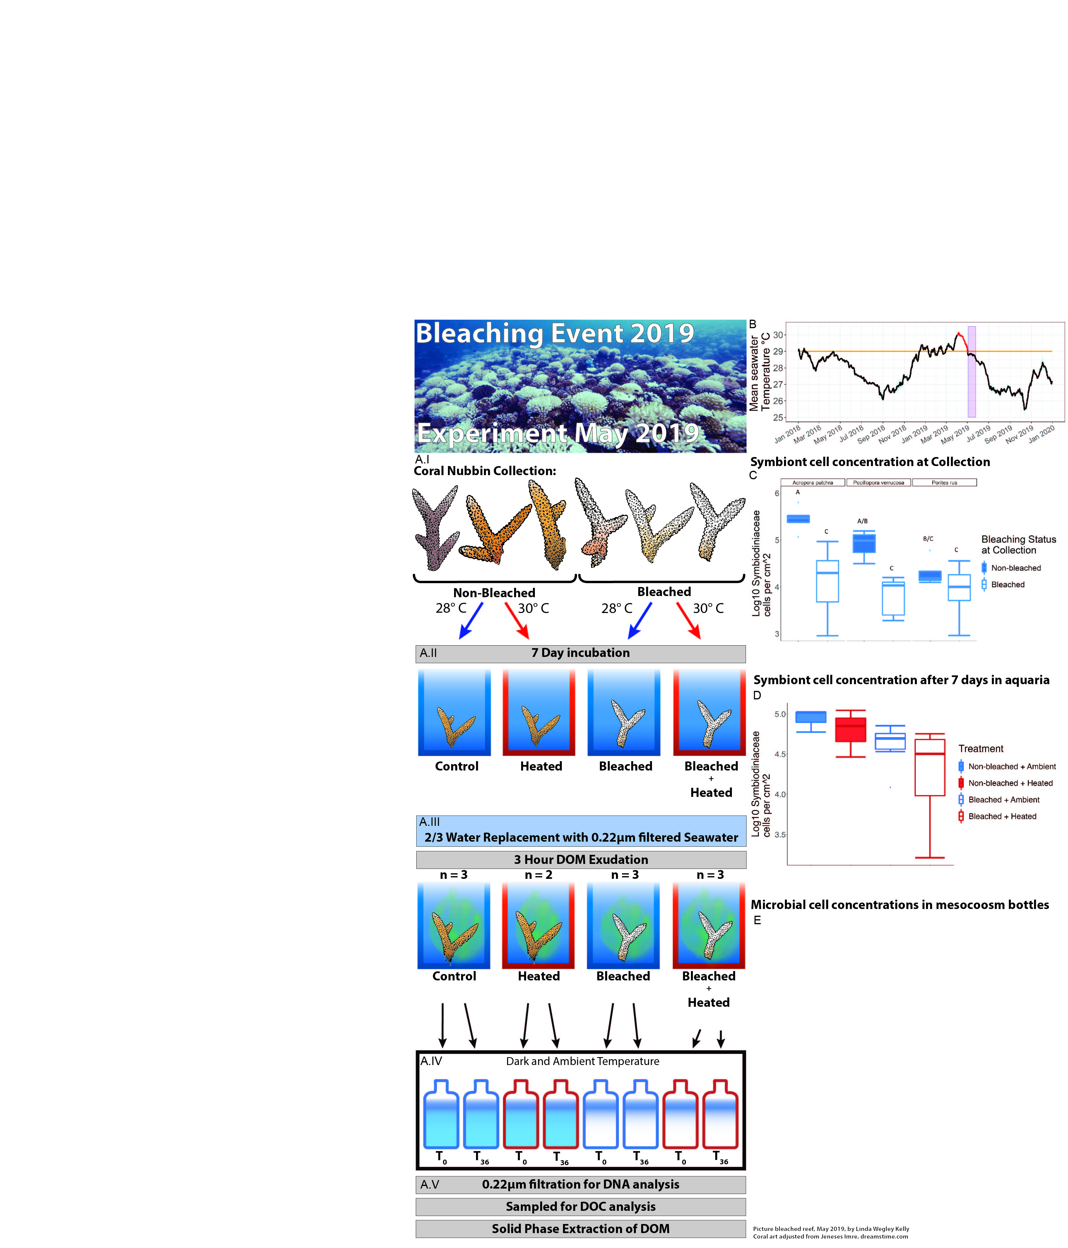
Stressed reef bacteria: Copiotrophs, putative pathogens, OM degraders
Healthy reef bacteria: Rhodobacteraceae, Cryomorphaceae
Stressed reef bacteria Copiotrophs, putative pathogens, OM degraders,
Stressed reef bacteria Copiotrophs, putative pathogens, OM degraders,
Hypoxia, disease
DOM
Hypoxia, disease
Hypoxia, disease
DOM
DOM
DOM
“Healthy”
“Thermal Stress Onset”
“Peak Bleaching”
“Recovering”
“Ecosystem State”
Treatment
Non-bleached + Ambient
Non-bleached + Heated
Bleached + Heated
Bleached + Ambient
Temperature
Time

